Slide 1
我的托负 My task
Titus 1:1-5

Slide 2
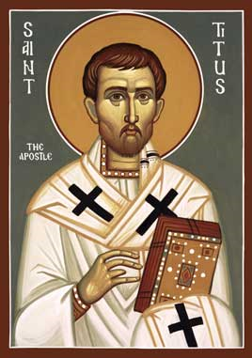

Slide 3
Apostle Paul
Physical Description of Paul from “The Acts of Paul and Thecla” (2nd century)
“A man small of stature, with a bald head and crooked legs, in a good state of body, with eyebrows meeting and nose somewhat hooked, full of friendliness.
4th century icon—the oldest image known of Apostle Paul

Slide 4
保罗生平 Chronology of Paul’s Life
保罗在路上遇见主归信耶稣 Conversion of Paul | 33 AD
保罗信主后第一次到耶路撒冷 Paul's First Visit to Jerusalem After Conversion | 35 AD
巴拿巴找保罗往安提阿事奉 Barnabas fetches Paul from Tarsus to Antioch | 45 AD
第一次宣教旅行 1st Missionary Journey | 47-48 AD
耶路撒冷会议 Jerusalem Council | 49 AD
第二次宣教旅行 2nd Missionary Journey | 50-52 AD
第三次宣教旅行 3rd Missionary Journey | 52-57 AD
在耶路撒冷被捕，被囚于该撒利亚 Arrest at Jerusalem, imprisonment at Caesarea | 57 AD
在罗马被关 Imprisonment at Rome | 60-62 AD

Slide 5
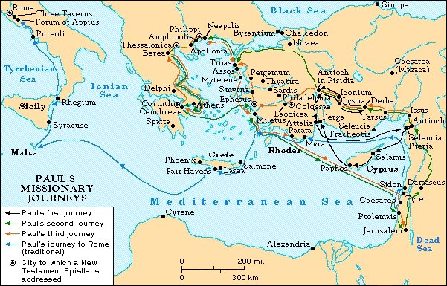

Slide 6
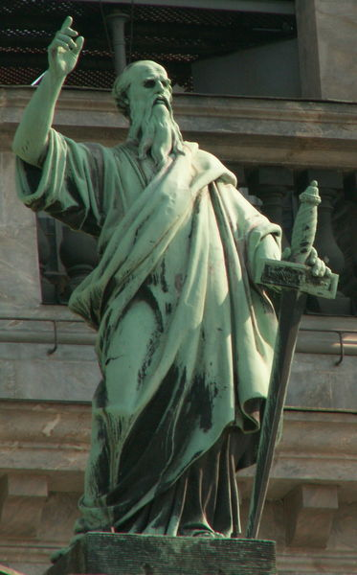
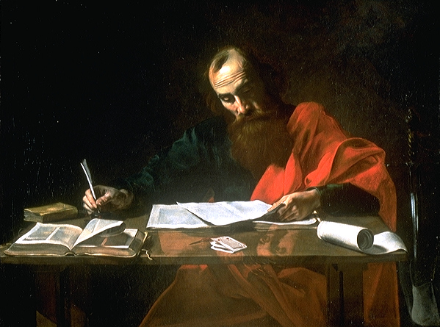

Slide 7
保罗生平 Chronology of Paul’s Life
被释放 Release from prison | 62 AD
写教牧书信（提前、多、提后）Wrote pastoral epistles | 62-65 AD
在罗马被软禁 imprisonment at Rome
殉道 Martyrdom at Rome | 65 AD

Slide 8
1. 我的身份 My Identity (1a)
Tit 1:1 神的仆人，耶稣基督的使徒保罗 ¹ Paul, a servant of God and an apostle of Jesus Christ

Slide 9
兩種奴仆 Two Kinds of Slave
罪的奴仆 Slave of sin
Eph 2:2 … 随从今世的风俗，顺服空中掌权者的首领 ² in which you used to live when you followed the ways of this world and of the ruler of the kingdom of the air,

Slide 11
兩種奴仆 Two Kinds of Slave
罪的奴仆 Slave of sin
神的奴仆 Slave of God
Col 1:13 他救了我们脱离黑暗的权势，把我们迁到他爱子的国里； ¹³ For he has rescued us from the dominion of darkness and brought us into the kingdom of the Son he loves
Gal 5:1 基督释放了我们，叫我们得以自由。 ¹ It is for freedom that Christ has set us free.

Slide 12
Exo 21:2-6 你若买希伯来人作奴仆，他必服事你六年；第七年他可以自由，白白地出去。 … (5) 倘或奴仆明说：『我爱我的主人和我的妻子儿女，不愿意自由出去。』 (6) 他的主人就要带他到审判官…用锥子穿他的耳朵，他就永远服事主人。
² “If you buy a Hebrew servant, he is to serve you for six years. But in the seventh year, he shall go free, without paying anything… ⁵ “But if the servant declares, ‘I love my master and my wife and children and do not want to go free,’ ⁶ then his master must take him before the judges…pierce his ear with an awl. Then he will be his servant for life.

Slide 13
Rom 6:16
… 或作罪的奴仆，以至於死；或作顺命的奴仆，以至成义。 ¹⁶ …whether you are slaves to sin, which leads to death, or to obedience, which leads to righteousness?

Slide 14
2. 我的托负 My Task (1b-3)
Tit 1:1 神的仆人、耶稣基督的使徒保罗（这是为着 神选民的信心，和那合乎敬虔真理的知识) [新譯本] ¹ Paul, a servant of God and an apostle of Jesus Christ for the faith of God’s elect and the knowledge of the truth that leads to godliness

Slide 15
2. 我的托负 My Task (1b-3)
叫人信福音 Lead people to faith –
“神选民的信心” the faith of God’s elect
造就信徒 Teach saints to grow –
“那合乎敬虔真理的知识” the knowledge of the truth that leads to godliness

Slide 16
3.我的盼望 My Hope
Tit 1:2-3 盼望那无谎言的神在万古之先所应许的永生， (3) 到了日期，藉著传扬的工夫把他的道显明了；这传扬的责任是按著神我们救主的命令交托了我。 ² a faith and knowledge resting on the hope of eternal life, which God, who does not lie, promised before the beginning of time, ³ and at his appointed season he brought his word to light through the preaching entrusted to me by the command of God our Savior

Slide 17
3.我的盼望 My Hope
Tit 1:4-5 现在写信给提多，就是照著我们共信之道作我真儿子的。愿恩惠、平安从父神和我们的救主基督耶稣归与你。 (5) 我从前留你在革哩底，是要你将那没有办完的事都办整齐了，又照我所吩咐你的，在各城设立长老。 ⁴ To Titus, my true son in our common faith: Grace and peace from God the Father and Christ Jesus our Savior. ⁵ The reason I left you in Crete was that you might straighten out what was left unfinished and appoint elders in every town, as I directed you.

Slide 18
我的身份? My Identity?
我的托负? My Task?
我的盼望? My Hope?

Slide 19
John 4:34
³⁴ 耶穌說：「我的食物就是遵行差我來者的旨意，做成他的工。
³⁴ “My food,” said Jesus, “is to do the will of him who sent me and to finish his work.

